Slide 1
Persuasive Techniques

Slide 2
A claim is the writer’s position on a problem or issue

Slide 3
An argument is a claim supported by reasons and evidence

Slide 4
Support is the reasons and evidence that back up the author’s claim.

Slide 5
A counterargument is the opposite viewpoint

Slide 6
Argument and Persuasion
Authors use carefully chosen facts and opinions to persuade readers.
Word choice is critical when persuading.
Authors present information based on their audience.
When analyzing persuasive text, the reader must identify whether or not the author was persuasive; NOT if you agree with them.

Slide 7
Advertisement
Write the numbers 1-4. Study the ad to the right and identify the following:
The issue
The claim
The support
A possible counterargument
Notes:
Issue: Teen drinking
Claim: Alcohol should NOT be served to teens
Support: It’s unsafe/Illegal/irresponsible
Possible Counterargument: If 18 year olds can fight for their country, they should be allowed to drink

Slide 8
Persuasive Techniques are:
Bandwagon Appeal
Ethical Appeal
Appeal to Fear
Appeal to Pity
Loaded Terms
Glittering Generalities

Slide 9
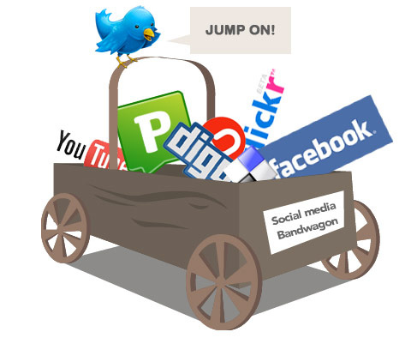
Bandwagon Appeal: taps into people who want to belong.
Example:
“Millions of teens have made City Jeans part of their wardrobe. What are you waiting for?”
“Most Americans believe that the minimum wage should not be raised.”

Slide 11
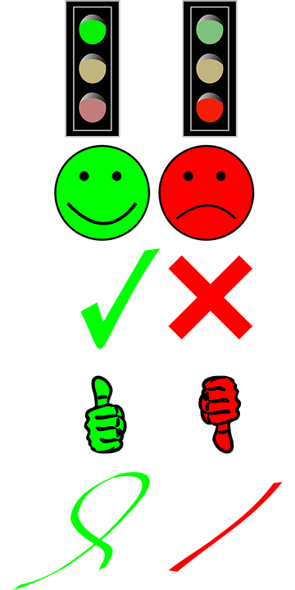
Ethical Appeal: tries to gain moral support for a claim by linking the claim to a widely accepted value.
Example:
“If you believe that every child deserves a good education, support the Great Minds Organization”
“Only citizens who feel that lying is acceptable would support this candidate.”

Slide 13
Appeal to Fear: makes people feel as if their safety, security, or health is in danger.
Example:
“How clean are the hotel rooms you’re staying in? You’ll be shocked by what our documentary reveals.”
“Terrorism could strike at any moment, in any town across the world. Protect your family by voting for Proposition 234B.”

Slide 15
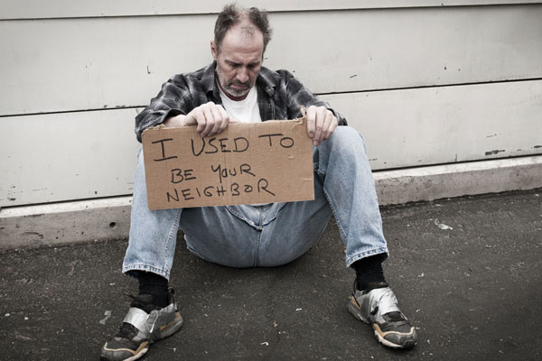
Appeal to Pity/Emotions: taps into people’s compassion for others.
Example:
“For the cost of one cup of coffee a day, you could save a life.”
“Here, we see a video of marine biologists removing a plastic drinking straw from the nasal cavity of a sea turtle. If humans continue to use wasteful plastic, our ecosystem will be in jeopardy.”

Slide 17
Loaded Terms: uses words with strongly positive or negative connotations to stir people’s emotions.
Example:
“The alley next to the parking lot is dark and dangerous. Vote to increase the number of street lamps in our neighborhood. Residents deserve to feel secure and protected instead of vulnerable.”
“The educator of the year is compassionate, supportive, and works constantly to ensure the success of their students.”

Slide 19
Glittering Generalities:are words that have different positive meaning for individual subjects, but are linked to highly valued concepts
Examples:
“Just like Mom used to make.”
“A vote for Mr. Jones is a vote for the good old days.”

Slide 21
For the next few slides, you will need a piece of loose leaf.

Slide 22
Issue
Claim
Support
Counterargument
Persuasive Technique
Audience
Notes:
Appeal to Pity/Emotions

Slide 23
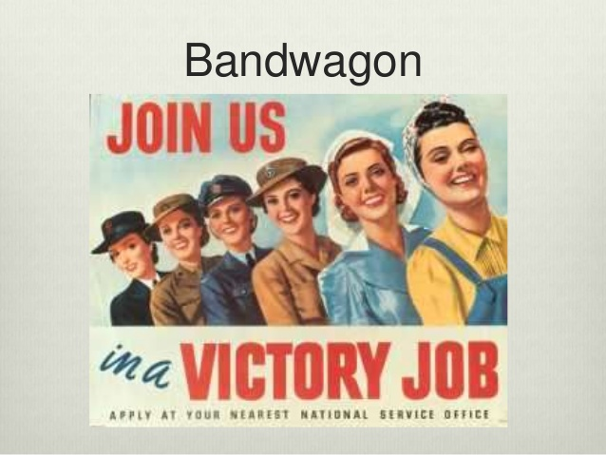
Issue
Claim
Support
Counter-
argument
Persuasive Technique
Audience
Notes:
Bandwagon

Slide 24
Issue
Claim
Support
Counter-
argument
Persuasive Technique
Audience
Notes:
Appeal to Fear

Slide 25
Issue
Claim
Support
Counter-
argument
Persuasive Technique
Audience
Notes:
bandwagon appeal

Slide 26
Issue
Claim
Support
Counter-
argument
Persuasive Technique
Audience
Notes:
Appeal to ethics

Slide 27
Issue
Claim
Support
Counter-
argument
Persuasive Technique
Audience
Notes:
Loaded terms

Slide 28
Issue
Claim
Support
Counter-
argument
Persuasive Technique
Audience
Notes:
Bandwagon

Slide 29
Issue
Claim
Support
Counterargument
Persuasive Technique
Audience
Notes:
Glittering Generalities

Slide 30
Issue
Claim
Support
Counterargument
Persuasive Technique
Audience
Notes:
Appeal to Fear

Slide 31
Issue
Claim
Support
Counterargument
Persuasive Technique
Audience
Notes:
Glittering Generalities

Slide 32
Issue
Claim
Support
Counterargument
Persuasive Technique
Audience
Notes:
Ethical appeal

