Slide 1
Narrative Nonfiction
Notes

Slide 2
What is narrative nonfiction?
a genre of writing that uses literary techniques to create factually accurate narratives, or a story.

Slide 3
Types of Narrative Nonfiction
Biography
Autobiography
Memoir
Diary

Slide 4
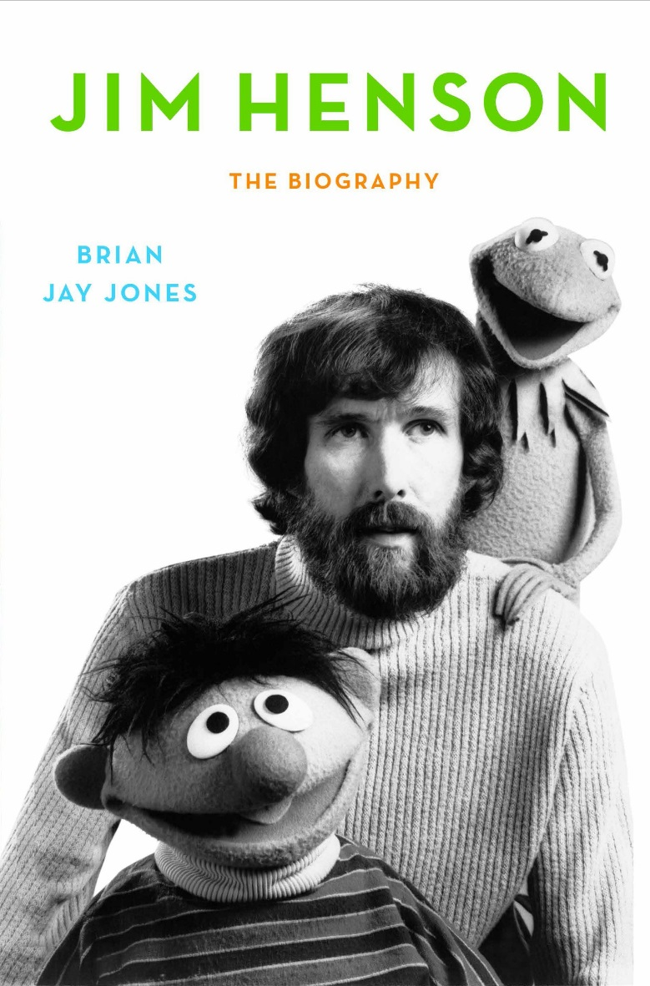
Biography
an account of someone's life
written by someone else
written in the third person
written in the chronological text structure (time order)
usually contains information up to the most
recent point of the subject’s life (or up to death)

Slide 5
Autobiography
an account of someone’s life
written by the person the narrative is about
written in the first person
follows the chronological text structure
contains information up to the most recent point of the author’s life

Slide 6
Memoir
a collection of memories about moments or events that took place in the subject's life.
written from the author’s memory
written in the first person
not always in chronological order
usually focuses on a specific topic (childhood, job experience etc)
doesn’t necessarily contain the most recent information/memories

Slide 7
Diary
a book in which one keeps a daily record of events and experiences.
written in chronological order
written in the first person
written as the events occur
information depends on how long author maintained diary
Diaries can be published whole or in parts

